Slide 1
How to develop one high performance C1M application gateway server with epoll()
jinyu@

Slide 2
Agenda
What is application gateway server?
What is the C1M problem?
Why epoll?
How to reach it with epoll()?
Some info.

Slide 3
What’s gateway server ?
Connection between 2 roles client and server;
  Hardware Gateway
  LVS
  Loadbalancer
  MySQL proxy
  Nginx
  …

Slide 4
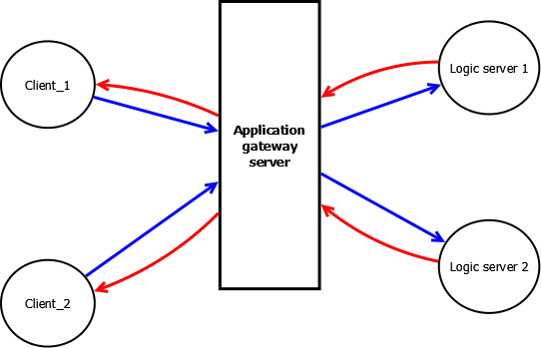
What’s gateway server ?

Slide 5
What’s gateway server ?
Gateway does:
  Sharding; (scalability/high performance)
  Failover; (high availability)
  DDoS shield;
  Connection holder;
Gateway doesn’t do:
  business logic;

Slide 6
What’s C1M problem ?
Initially it’s C10K problem
  One server holds 10K+ concurrent connection;
Then C100K
  Because the Internet grows fast;
Now it’s C1M
  Because of the Internet, Mobile Internet, Web 2.0, customer experiences…

Slide 7
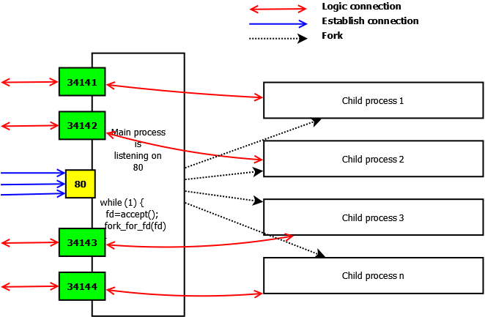
Why epoll()?
  Traditional client-server model: multi-processing

Slide 8

Why epoll()?
  In next: multi-threading

Slide 9
Why epoll()?
Both works well with small number of concurrent connection;
But when connection number grows, they both have those problems:
  No free memory
  CPU Load is high
  CPU io_wait is high
  Too much DoS

Slide 10
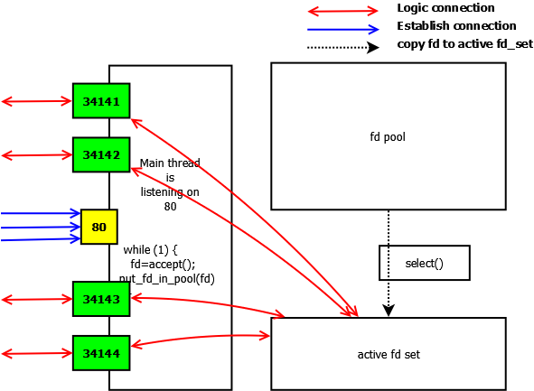
Why epoll()?
  Some genius introduces select(), then:

Slide 11
Why epoll()?
The select() can handle <1K connection in one thread with
  less memory
  lower CPU load
  lower io_wait.
Why select() is better?
  No cost for proces/threads;
Why <1K?
  select() is actually poll() all to-be-checked fds. It wastes of CPU;
  1K is one hard-code in Linux kernal;

Slide 12
Why epoll()?
How to resolve C10K?
  The answer is aio/epoll();
The epoll() likes select(), but it is really better:
  epoll() has no the 1K limitation;
  epoll() is triggered by The Linux Kernel;
In lab env, I got 3M connections with a little of Kernal tuning;

Slide 13
How to reach it with epoll()
Firstly, you need one good machine
  16 CPU, 16GB, 2 x 1GB adapter
  a good latest stable Linux release: like Centos 6.4 final;
Then, you do following performance tuning like below:
  net.ipv4.ip_local_port_range = 1024 65535
  fs.file-max = 3072000
  fs.nr_open = 3072000
  net.ipv4.tcp_fin_timeout = 5
  net.ipv4.tcp_tw_recycle = 1
  net.ipv4.tcp_tw_reuse = 1
  net.ipv4.tcp_mem = 786432 1048576 1572864
  net.core.netdev_max_backlog = 1000
  net.core.somaxconn = 256
  net.ipv4.tcp_max_tw_buckets = 5000

Slide 14
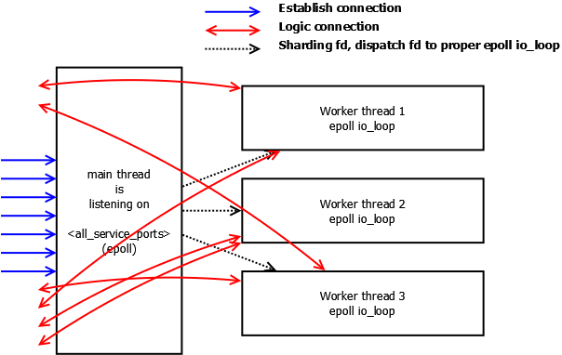
How to reach it with epoll()
Design you system like mine:

Slide 15
How to reach it with epoll()
It looks like the traditional multi-threading, but:
  It is a thread pool;
  It is not sync_io, it is async_io. Each worker thread is running one individual epoll io_loop;
  Main thread accepts fds, and dispatch fds to proper thread for handling;
  Worker threads will take proper action for the full life-cycle for assigned fds;

Slide 16
Some info
One Android Push system for CN
    2M+ connections
    60K+ outbound messages per 1 second
    <=7GB memory
    io_wait around 0
    Idle around 50% (total 8 CPUs)

Slide 17
Thanks

